Slide 1
Your Map to Recovery:
After a Road Crash
Presented by Clare Robbins
23rd September 2020
Notes:
Presenters bio – area of expertise.
As we have learnt from this morning – MaPS on our Road is a co-designed and collaborative project with the heavy vehicle industry to ensure the relevance of the topic.
We aim for this presentation to help put the mental and physical issues truckies face after a road crash to encourage open dialogue and support.
Talk about road crashes
Who is impacted – drivers, passengers, witnesses, first responders, family member, colleagues friends etc.

Slide 2
Notes:
I would like to begin by acknowledging the Traditional Custodians of the land on which we meet today, and pay my respects to their Elders past, present and emerging.
I extend that respect to Aboriginal and Torres Strait Islander peoples here today.

Slide 3
Support and Help
If you have been impacted by road trauma or mental health concerns, support is available through:
Road Trauma Support WA 1300 004 814, rtswa.org.au
Lifeline 13 11 14, lifeline.org.au

Slide 4
Workshop overview
Develop an awareness of the involvement of heavy vehicles in road crashes in WA
Gain an understanding into what makes a crash a stressful event
Identify and develop an understanding of the common reactions after experiencing a road crash
Identify the changes to a person’s life after a crash
Identify the supports available after a crash
Notes:
This is a brief snapshot of the supporting yourself and other’s workshop. Explain that for more detailed workshop we have a 2 hour presentation.

Slide 5


Activity – Discuss in pairs
Your experience of being impacted by a road crash or a stressful situation
What were the circumstances around the event?
What feelings did you experience?
Did you experience any well-being issues after the event?
Notes:
Repeat message from earlier. Give a well-being and emotional safety message before the activity.
Advise them to only share what they feel comfortable sharing.
Goals:
To get the audience to think and connect with then they had experienced a road crash.
What was it like for them?
What feelings came up for them?
Make a note on the white board of each component – use it to refer back to during the session. Identify common themes and patterns.

Slide 6
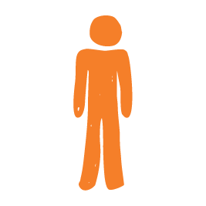

What we know!
Truckies are often first on scene of a road crash
Over half the crashes in metro area involving a heavy vehicle resulted in a fatality or serious injury.
Reference: WA Road Safety Commission (2020)
Notes:
AIM – to provide link the participants with the stats they have just learnt.
Often Vehicle Operators are first on scene of a road crash
For remote area’s this could mean Vehicle Operators are with the crash victims for hours on their own.
For many after the first responders arrive and take over, the HVO are able to continue on their journey. But without the opportunity to talk though what they have just witness or taken part in. Often now under pressure to makeup the time.
For many it’s not until they stop for the night or are back home that they being to think through what they saw and experienced.
For many it would be normal to put the event to the back of their head and carry on as if it’s all in a days work but your mind and body need to process the experience some how and this can lead to other physical or mental health issues.

Slide 7

Impact of Road Trauma in WA
FATALITIES 2019
163 people lost their lives
99 regional and 65 metropolitan
As at 20 September 2020
105 people lost their lives
62 regional and 43 metropolitan
Reference: WA Road Safety Commission (2020)

Slide 8

Road Crashes in WA from 2015 - 2019
541 people killed or seriously injured in crashes involved at least one heavy vehicle in WA.
150 heavy vehicle occupants were killed or seriously injured in a crash in WA.
Reference: WA Road Safety Commission (2020)
Notes:
AIM – to provide the participants with a general understanding around the frequency of heavy vehicle crashes.
Between 2015-2019, there were 541 people killed or seriously injured (436 serious injuries and 105 fatalities) in crashes involving at least one heavy vehicle in WA.
Between 2015-2019, were 541 people killed or seriously injured (436 serious injuries and 105 fatalities) in crashes involving at least one heavy vehicle in WA
Between 2015-2019, half (51%, n=276) of people killed or seriously injured in crashes involving at least one heavy vehicle in WA were in the metropolitan area.
Between 2015-2019, 72% (n=387) of people killed or seriously injured in crashes involving at least one heavy vehicle in WA were male.
Between 2015-2019, 72% (n=387) of people killed or seriously injured in crashes involving at least one heavy vehicle in WA were male.

Slide 9
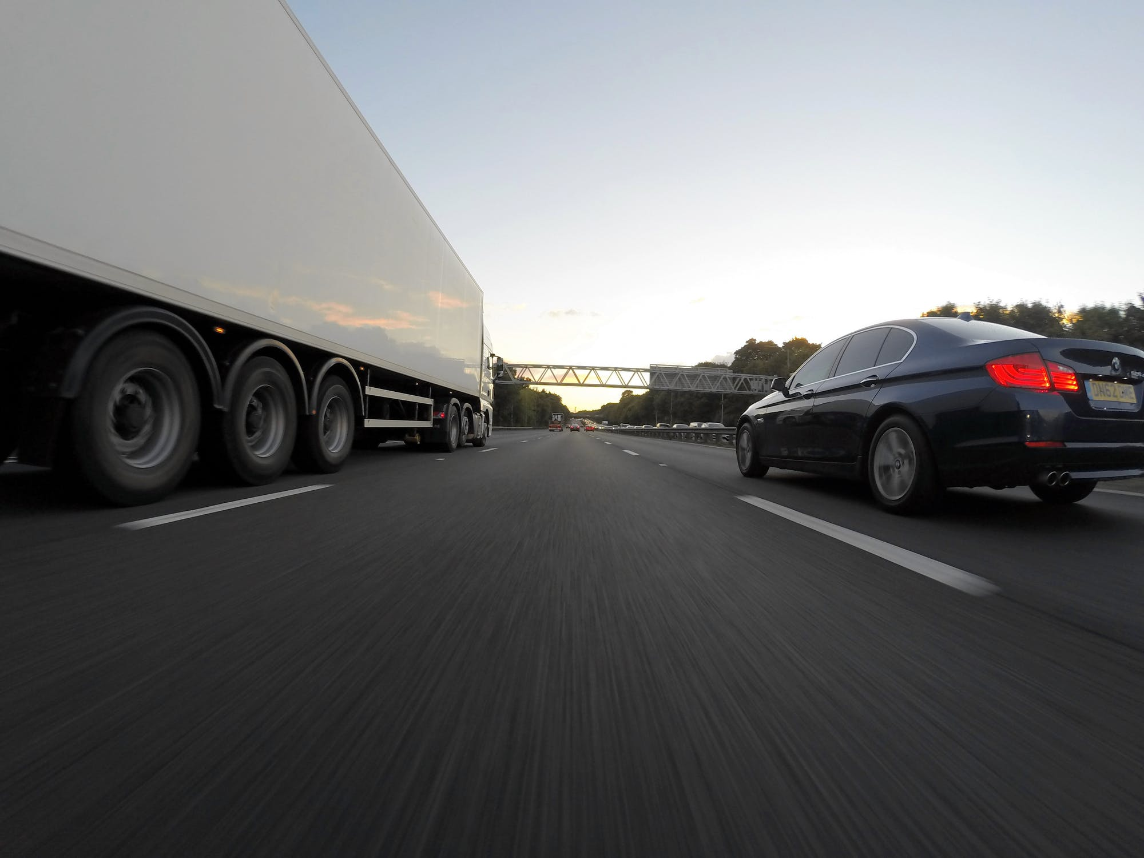



Where at least one heavy vehicle was involved
17% speed related
15% fatigue related
10% inattention related
Reference: WA Road Safety Commission (2020)
Notes:
AIM – to provide the participants with a general understanding around the common behaviours resulting in heavy vehicle crashes.
Between 2015-2019, the following factors were suspected to be a contributing factor in crashes involving at least one heavy vehicle in WA;
17% (n=91) speed.
15% (n=83) fatigue.
10% (n=52) inattention. Note - it was unknown in 90% (n=487) of incidents.
Presenter Notes Only
Reference – NHVR Newsletter Issue 95
Truck fatalities down
Recently released data from the Bureau of Infrastructure, Transport and Regional Economics (BITRE) has shown a significant reduction in heavy vehicle crash fatalities over the 12 months to June 2020.
NHVR CEO Sal Petroccitto said that the data was encouraging but that there was never room for complacency.
“Over the past financial year there were 157 fatalities recorded, down 17.8 per cent on last financial year,” Mr Petroccitto said.
“This includes a 30.4 per cent reduction in fatalities involving heavy rigid vehicles and a 7.8 per cent reduction in fatalities involving articulated vehicles.
“Of course, any death in a crash is one too many and we are always focused on what we can do to make our roads safer for all users.
“We are continuing to remind drivers that we need space to keep you safe – targeting drivers of light vehicles, who are most often at fault in crashes involving trucks.”

Slide 10
What makes road crashes stressful events?

Slide 11
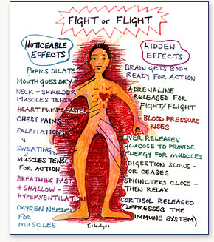
What happens to us
Prepare for action
These are normal
Body tenses
Adrenaline is released
Notes:
AIM – to provide the participants with an understanding around stress reaction our bodies go into when put in perceived stressful situations.
What happens to us:
When we encounter a road crash whether it is because
our vehicle is involved
We witness the crash
We are a passenger in a vehicle
We learn a loved one has been involved in a road crash
Or we come upon the scene of a crash
As human beings our bodies will go through certain stages
Stress hormones are released – adrenaline and cortisol
Our muscles will tense
Our breathing will become shallow
Our Hearts start pumping blood faster.
So when we get our the cab to see what’s happened
Our bodies are prepared for action.
Depending on the circumstances of the event and our own life stresses is how we will react at this time.
We could jump into action – sorting out the situation, call 000 and tending the others
Or we could freeze and be uncertain what to do or how best to assist the situation.
Or we could be injured and unable to help.
These reactions will have an impact how we mentally recover from the event.

Slide 12
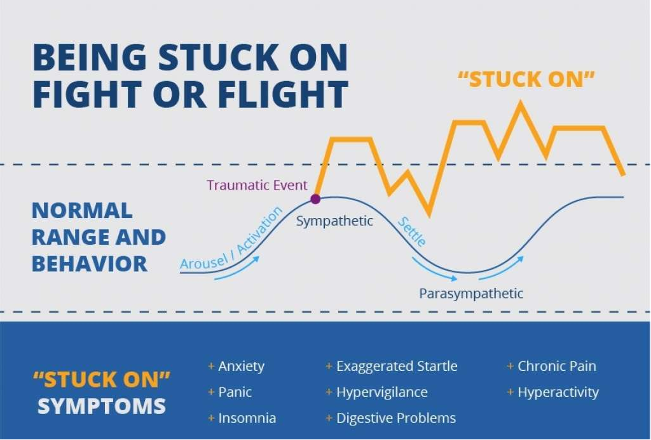
Notes:
Being stuck on fight or flight
Research has shown when we are in this fight or flight state it will take AT LEAST 24 hours for our bodies to go back to the pre-crash state.
However, due to other stresses at the time or previous crashes we get stuck on this hyper state. Whilst this hyper state was very useful at the time of the crash – it is very unhealthy on a mental and physical level after the crash.
The hyper state can lead us to feel:
Anxious
Panicky
Unable to sleep
Hypervigilant
Stomach issues
Chronic pain
Hyperactivity with the inability to settle.
As people who work in the industry we need to be mindful of these states with our colleagues and mates.

Slide 13
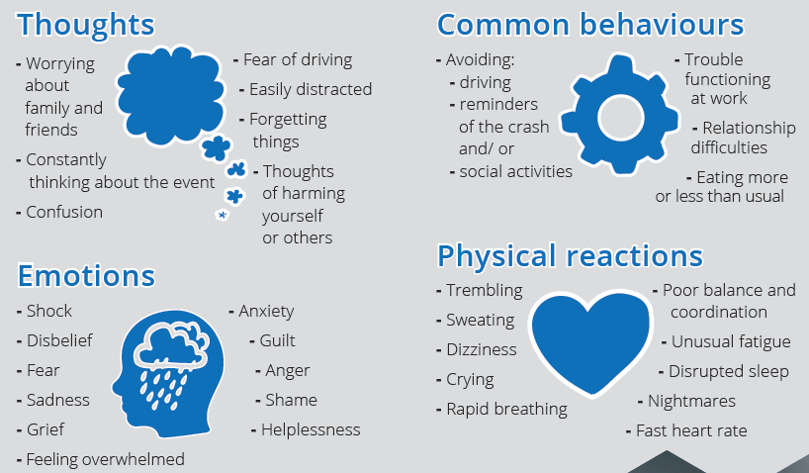
Common reactions after a road crash
Notes:
AIM – to provide the participants with an understanding around the common reactions. Normalise their experience.
After saying all that
These are the common reactions someone who has been impacted by a road crash can experience.
These common reactions can last up to 3 -4 weeks after the crash.
They also may not appear until a couple of weeks after a crash.
We need to support and normalise these reactions with our colleagues and mates.
I will talk about support and how best to support yourself or others a little later.
It’s normal to feel any of the above up to 6 weeks after the crash.
Emotional reactions can include:
Shock, disbelief, anxiety, sadness, grief, guilt, irritability, anger, overwhelmed, feeling vulnerable, excessive worry.
Physical reactions can include:
Shaking, sweating, breathing rapidly, increased heart beats, stomach churning, crying, restlessness, poor sleep, on-guard, startle easily
Behavioural reactions can include:
Avoiding people, being super cautious, over-reacting to small upsets, avoiding the scene of the trauma, try to escape feelings/thoughts
Thinking reactions can include
Excessive worry; going over and over what you saw, heard, did at the scene; difficulty accepting what happened; poor concentration, can’t pay attention, memory problems, nightmares or flashbacks (re-living) of the trauma.
Stress they can access support during this time if feeling overwhelmed.

Slide 14

Risk Factors after a crash
The isolation of the job.
“14 hours of driving time is a lot of time to sit with your thoughts”
Additional Pressures
  Time pressures
  Concerns about your job
  Limited access to support or unsure who is best able to support you
  Possible an unhealthy ways of managing pressure
  Pre-existing mental health issues
  Relationship issues
  Family issues
  Having reminders or triggers of the crash
Notes:
AIM – to start linking what they have learnt to their roles and how this may impact when they are on the road. Attitude to just get back on the road.
Due the nature of the road whether a long or short distance driver – VO will spend most of their working day on their own. This can result in ruminating thoughts, raised anxiety levels. The long hours can increase the opportunity to over think, compounding negative thoughts processes and therefore making your emotional state worst. “14 hours of driving time is a lot of time to sit with your thoughts”.
Additional Pressures
Having reminders or triggers of the crash. These could be conscious reminders or unconscious reminders or triggers such as driving past the crash sight or hearing the same song which was playing at the time of the crash. Or simply being in the same truck or driving the same route.
All will have an mental health impact on the VO.
Time pressures – Busyiness of the industry
Limited access to support or unsure who is best able to support you. In the general demographic if the industry tends to be older males whom have been “brought up” on not seeking emotional support and with a perceived stigma on those that do.
For many
Possible an unhealthy ways of managing pressure - Unhealthy ways of managing pressure – norm to drink a few beers in an evening – this may increase after a crash, increase
Pre-existing mental health issues - If your vehicle drivers already have a pre-existing mental health issue, then the traumatic incident may be even more distressing and maybe a trigger or worsen the symptoms of their condition.
Relationship issues??

Slide 15

After a road crash “Unless offered help at the time, where do they go and how do they find someone involved with trucks that will understand and help them”

Slide 16
Changes to your life
Physical
Emotional
Financial
Social
Notes:
AIM – to provide the participants with an understanding around the common wider implications people experience after a road crash.
Whilst someone is experiencing this emotional turmoil the crash can have a ripple affect across their life which too will put add stress on them.
For example
An ex client of mine – Eddie (name change) has been driving trucks for over 25 years. Eddie is married and has four children. One adult from a previous relationship and three younger children with his current wife.
Eddie now has his own 30-ton truck which he is contracted to deliver fruit and veg in the metro area. Previously Eddie has been a long-distance driver driving intrastate.
Whilst Eddie was on the delivery run one morning a small van came out of nowhere and smashed into Eddie’s cab. Eddie was shaken but felt OK. His wife picked him up and the tow truck collected his vehicle.
Eddie spent the next couple of days sorting out his insurance paperwork and helping his son move to a new house.
The fifth day after the crash Eddie was unable to get out of bed. Eddie managed to get himself to his GP who told him to go to A&E.
Eddie was diagnosed with a cracked and compressed vertebra in his neck and needed an operation.
Eddie was in hospital for 2 weeks and lived in a brace for another 3 months.
Eddie managed to return to work but is unable to sit for longer than an hour or so, he struggled to get in about of the cab and often his hands felt numb.
Eddie has had to give up work as he is in constant back pain, his arms and hands have got nerve damage which makes holding things tricky and he is prone to getting migraines due to the build up of pressure in his spine and head.
Eddie’s family had had to adapt to Eddie no longing the breadwinner with his wife returning to full-time employment.
Eddie can no longer play footie with his sons. Eddie is unable to thread his fishing line. Fishing was his passion and the way he relaxed and process life.
Eddie always had a temper but since the crash his anger has amplified with a build up of frustration around his situation and the unfairness of what happened to him.
Eddie is a proud man and see is role in the family as the breadwinner and fixer. If a job needed doing Eddie would sort it. Eddie can no longer do this.
Eddie came for counselling support as his relationship with his wife had reached breaking point and she was talking about ending it.
Eddie is still receiving counselling but his anger with the world has reduced.
Eddie is coming to terms with the unforeseen changes this road has had on his life and is learning to finding a new norm.
Eddie biggest regret to date is he recently become a grandfather for the first time but due to the nerve damage he is unable to hold his new grandson without support.
Changes to your life
Invite the participants to think about the Physical, Emotional, Financial and Social changes Eddie has and is currently experiencing after a road crash.
The changes in Eddies life on a
Physical: - Back injury – constant pain. Headaches and migraines. Nerve damage.
Emotional – Anger issues whilst Eddie had a temper this amplified as he recuperated resulting in relationship issues and disconnection from his family and friends. Eddie thought no one could understand what he was going through. The whole situation was totally unfair.
Financial – Loss of income and change of income which had implications on what they could afford to spend. They were unable to afford foreign holidays, meals out etc. This resulted in resentment from the children as their friends seems to going on holidays every school break and Eddies children stayed at home.
Social – Eddie and his wife were a very social couple always hosting bbq for friends and family. Eddie no longer had the energy (or money) to do this. Eddie preferred quiet nights in at home and early to bed. Eddie can’t drink alcohol anymore due to his medication. All his mates connect with each other over a beer or two. Eddie no longer feels he has anything in common with his mates.
Eddie is an extreme case I am hoping provides you with an idea of the additional changes someone may go through after a road crash.
Those of us who have experienced a road will expect some change on a level:
Anxiety around driving.
Taking time out for medical appointments
Sorting out the insurance paperwork.
Loss of income.
Leading to…

Slide 17
Emotional build up
Overwhelmed by everyday events
Unable to stop thinking about the crash
Questioning why has this happened to me
The unfairness of the situation
Difficulty concentrating
Feeling fatigued
Notes:
Recap on what was discussed in the previous slide linking each to the boxes above.
Emotional Build Up
At some point, most people will have an emotional build up and think:

Slide 18
The psychological effect of road traffic crashes
High Risk (< 10%)
Support: mental health professionals
Moderate Risk (35%)
Support: peer support group
Low Risk (60%)
Support: family and friends
Adapted from: Aoun, Breen et al. (2015)
Notes:
The need for support:
Only 10% of us who are affected by a road crash will need professional support.
Most of us process the event with support from family, friends and colleagues.
As a colleague and friend we need to acknowledge what their colleague or themselves has been through. On an individual level not standard. Just because Bill had a crash and then was back at work the next day doesn’t mean Mike will be the same.
High risk- at risk. May need referral to mental health professionals
Moderate risk- In need of some additional support. E.g. peer support group
Low risk- majority of individuals deal with support of family and friends.

Slide 19
Seeking Support for yourself
Talk to someone you trust
  Partner
  A family member
  Mate
  Colleague
  Your GP
  Injury Matters
  A Counsellor
  Employee Assist Program provider (EAP)
Do an activity that brings you joy
Walking
Fishing
Golf
Reading
Playing a team sport
Breathing exercises
Catching up with your mates
Maintain a healthy routine, diet and sleep
Notes:
Recognise you have been through a stressful event.
Most of us rally around and support mates and colleagues after a crash often it is much later when support is required or needs to be continued/ on going
Support need to be flexible and varied depending on the needs of the person and what they experienced.
Also spending doing something you enjoy which gives you a mental break.
Read the slide for activities.
Explain that self-care is personal and individual.
You need to ascertain what self care strategy works for you.
The strategy doesn’t want to become a burden and another thing you have to do.
TIME

Slide 20
Activity – Discuss in pairs
Talk briefly to the person next you about what your company does well in supporting their truck drivers?
What support would you like to see within the heavy vehicle industry, if any?
Notes:
Give a well-being and emotional safety message before the activity.
Goals:
To get the audience to think and connect with then they had experienced a road crash.
What was it like for them?
What feelings came up for them?
Make a note on the white board of each component – use it to refer back to during the session. Identify common themes and patterns.

Slide 21
What happens when staff don’t feel supported
Staff become stressed and burnout
Productivity decreases
Inability to do their job well
Mistakes occur
More sick leave taken
High staff turnover
Drain on company resources
Overall company performance and reputation can go down.
Notes:
Employee burnout is a huge issue for many companies, and a major reason that talented workers leave for better opportunities. One way to combat employee burnout is to re-dedicate the company to the employees’ well-being and aligning that approach with company values. Overworked, overburdened, and overly stressed employees can take a noticeable toll on any company.
Employee productivity decreases with a lack of motivation, working slower, and lowering productivity.
Sick leave time is taken much more frequently when burnout is pervasive as it leads to anxiety and increased instances of illness.
Increased errors in completed work and/or correspondence occur more frequently, affecting quality as well as company profits.
High turnover rate is a common trend if employee burnout is widespread throughout the company and employees are regularly overworked.

Slide 22
MaPS on our Road workshops
Your MaP to Recovery: After a Road Crash
OR
Your MaP to Recovery Supporting a staff member after a Road Crash
Other topics to be covered:
Supporting a mate and or colleague.
What is PTSD and how to recognise it in other’s.
Gaining a greater awareness of triggers after a road crash.
Developing a return to work plan.
Wider range of self-care strategies.
More interactive with activities throughout the workshop.
Presentations can be:
Tailored to meet your companies need.
Either two or six hours (full day) workshops.
All workshop and support resources supplied.
Notes:
Today’s presentation is a snap shot of the type of topics we cover in our Supporting yourself and other’s after a road crash and Supporting a staff member after a road crash.

Slide 23
Your MaP to Recovery –
After a Road Crash
Support
Telephone Support
Workshops
Supporting self and others- After a Road Crash
Supporting a staff member- After a Road Crash
Resources
Brochures
Fact sheets
Email support
Website
1300 004 814
injurymatters.org.au/mapsonourroads
Notes:
Support Provided by MaPS on our Roads
Someone to speak to
Mental Health First Aid
Counselling (via Road Trauma Support Services)
Referrals and links to other services
Presentations:
MaPS on our Roads presentations are adaptable to be delivered as a workshop or as part of a toolbox session - from 45 mins or 6 hours in duration.
The presentation are:
Supporting yourself and others - After a Road Crash
Supporting a staff member – After a Road Crash
If your company would like the presentations to be tailored to need your company procedures, there may be a small charge for this tailoring.
Each presentation will be available as a webinar as the campaign progresses.
Resources available to compliment the After a Road Crash – Your MaP to recovery campaign.
Information and Fact Sheets
RTSWA – After a Road Crash
RTSWA- For anyone affected by a road crash
RTSWA- witnessing road trauma
RTSWA - Coping with sleep difficulties following road trauma.
MaPS – Living with Loss following road trauma
MaPS – Heavy Vehicles Wallet Card

Slide 24
Supports Available
Injury Matters
1300 004 814 (8.30am- 4.30pm)
www.injurymatters.org.au
Lifeline
13 11 14
Crisis Care
(08) 9223 1111 or 1800 199 008 (free call)
Australian Centre for Grief & Bereavement
www.grief.org.au
Journey Beyond Road Trauma
www.journeybeyondroadtrauma.org
Rural Link
1800 552 002
Beyond Blue
1300 224 636
Suicide Call Back Service
1300 659 467
GriefLine
1300 845 745
My Grief Assist
www.mygriefassist.com.au
Industry and Local Supports
Healthy Heads in Trucks and Sheds
info@healthyheads.org.au
Small Business Development Corporation
133 140
Yorgum Health Services
1800 469 370
Family Relationships online
1800 050 321
Citizens Advice Bureau
9221 5711
Insurance Commission of WA
(08) 9264 3333

Slide 25
Thank You
&
Questions

Slide 26

Please take a few moments to complete an evaluation
We value your feedback!

Slide 29



Connecting with MaPs on our Roads services
(08) 6166 7688
info@injurymatters.org.au
injurymatters.org.au/mapsonourroads

Slide 30
Where to from here?
Being involved in the project
Booking a presentation
RECEIVING TELEPHONE SUPPORT
Notes:
Booking a presentation:
To book this presentation or supporting a staff member after road crash please contact us – details to follow. Each presentation will be presented as a webinar for our working owner drivers and anyone else who can’t attend in person.
The webinar dates will be posted on IM FB page or if you would like to
We don’t want this to be a one off presentation.
Telephone Support
Call 08 6166 7688 and ask to speak to MaPS on our Roads services.
Involved – as mentioned at the beginning of the presentation MaPS on our Road project is a collaborative project. We want – we need your feedback and ongoing support to help make a difference and a safer workplace and safer roads in WA.
To receive information on this campaign or other MaPS on our Roads campaigns please give provide us with your contact details by XXXX

Slide 31
Other external supports available
Healthy Heads in Trucks and Shed info@healthyheads.org.au
Small Business Development Corporation 133 140
Mensline 1300 78 99 78
Beyond Blue 1300 22 46 36
Citizens Advice Bureau 9221 5711
Family Relationships online 1800 050 321
Yorgum Health Services 1800 469 371
Injury Matters 6166 7688

Slide 32
Trauma notes
Trauma Notes:
We also are likely to have a trauma reaction when we impact a road crash.
Trauma is when we think and feel our lives or the lives of other are threaten. It’s a human reaction to the exposure to actual or threatened death, serious injury or violence.
Whether this is a real or perceived threat. Something that it beyond our control.
Trauma is a normal response to an abnormal event.
It may happen to you, you may see or hear about it happening to someone else, or you may be involved in the aftermath of a horrific event.
What happens to you when you are in a traumatic situation:
Your mind slows. The reason behind this is to prevent your mind from becoming overwhelmed. However, Trauma does get stored in our senses – sight, sound, smell, touch, hearing. Many on an unconscious level.
These senses will relate to any triggers you may experience later.
Trauma memories or experienced aren’t stored as an everyday events are done. They are stored in sections often not in a sequence. We may attach a different non rational meaning to the event – I feel anxious when driving a truck etc. Change the example depending on the participants attending and their lived experience already shared.
This traumatic experience needs to be acknowledged, respected and time given to process/reflect on what you experienced. Even if you feel OK.
Your may be still in the hyper stage. Over time (and with support) you will be able to recall the event coherently without feelings overwhelmed.

