Slide 1
TRANSAFE
Mike Buba

Slide 10
Network Analysis Example – Operators linked to offences
Notes:
IBM i2 Analyst’s Notebook software
Visual analysis tool that turns data into intelligence
Operators can be linked to offences, vehicles, locations or many other entities
Social network, geospatial or temporal analysis charts available
Will greatly assist Compliance with focusing on recidivist operators

Slide 11
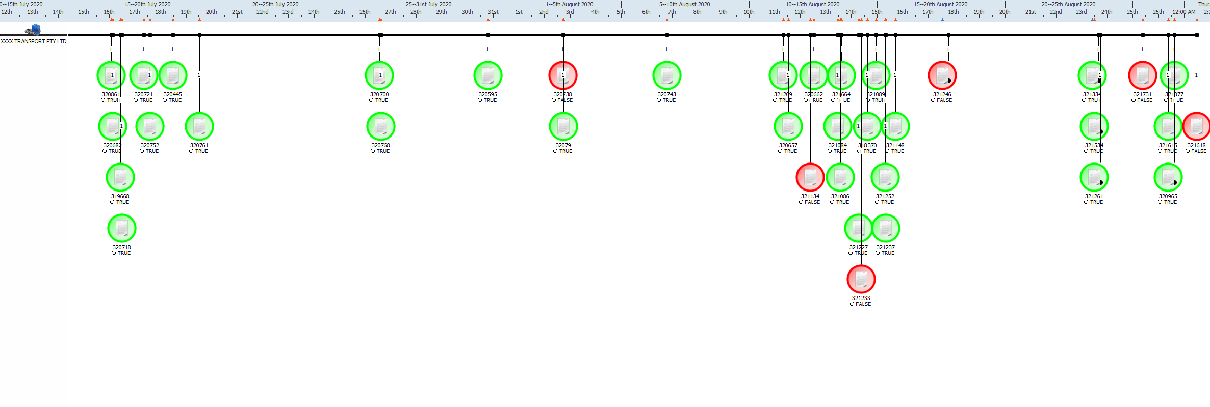
Timeline Analysis Example 1 –
An operator’s intercepts based on compliance record
Notes:
Timeline Analysis Example 1 – An operator’s intercepts based on compliance record
Visual timeline of intercepts based on compliant or non-compliant event
Ability to display clusters to highlight frequency of intercepts

Slide 12
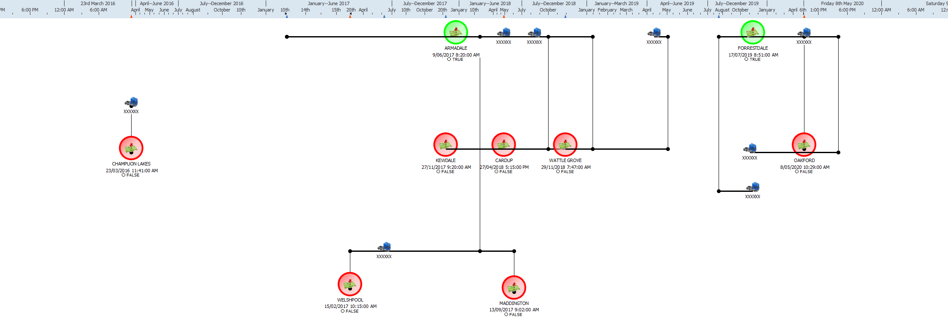
Timeline Analysis Example 2 – An operator’s intercepts
based on compliance record and linked to trucks/ locations
Notes:
Timeline Analysis Example 2 – An operator’s intercepts based on compliance record and linked to trucks / locations
Ability to display links and events in chronological order for operator compliance
Hotspot locations can be recorded for future enforcement deployment

Slide 13
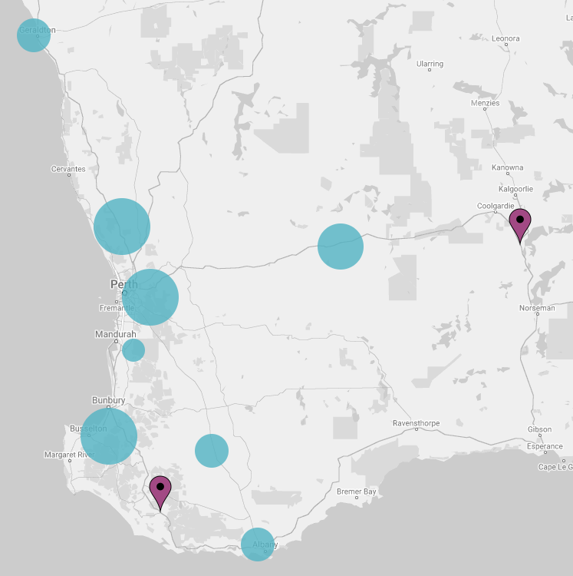
Regional Roadwork Projects
In June this year, the Government announced it had secured Commonwealth funding to upgrade 1,400 kilometres of regional roads with shoulder sealing and audible edge lines.
These low-cost treatments have been shown to greatly reduce the number of run off road crashes, which can result in severe trauma. Modelling undertaken using roads where the same safety treatments have been introduced shows this strategy could reduce road trauma in regional WA by as much as 60 per cent.
A full list of all the Regional Road Safety improvements to be undertaken over the next 12 months can be found at mainroads.wa.gov.au
Notes:
We know there is a lot going on at the moment and that roadworks and detours can be frustrating, but we’re focussed on the end result and ultimate goal of reducing the number of lives lost.
While the upgrades may cause delays to your journey over the summer, every construction sign is a sign of great things to come. We’re actively work to help improve the State road network and reduce the risk of killed and seriously injured crashes on our roads.

Slide 14
Regional Roadwork Projects
Thirty projects have been funded and are already underway across the State with the below work planned for some of the State’s major freight routes:
255km of Great Northern Highway through the Mid-West, Pilbara and Kimberley
240km of Eyre Highway through Goldfields Esperance
165km of Albany Highway through the Perth Metro, Wheatbelt and Great Southern
141km of Brookton Highway through the Perth Metro, Wheatbelt and South West
124km of South Western Highway through the South West and Great Southern
115km of Great Eastern Highway through Wheatbelt and Goldfields Esperance
75km of Burkett Road in the Mid West
58km of Sues Road in the South West
50km of Chester Pass Road through Great Southern
Improvements will also be undertaken on roads including York Merredin Road, Goomalling Merredin Road, Northam Toodyay Road, Northam Cranbrook Road, Brand Highway and Indian Ocean Drive.
Notes:
Regional roads will be made safer, with much needed road safety treatments being delivered across the state in the first of a nine-year program.
Thirty projects will see more than 1,400 kilometres of roads upgraded
Goldfields – Esperance –
Installation of audible edge lines 240 km of Eyre Highway east of Norseman due to commence in October 2020 and is expected to be completed May 2021
Widen and seal shoulders, and install audible edge lines 25 km of Great Eastern Highway east of Ghooli and is expected to start in November 2020 to be completed January 2021
Great Southern - Upgrades and improvements from November 2020 to June 2021:
50 km of Albany Highway between Mount Barker and Albany
5 km of South Coast Highway between Albany and King River
20 km of South Western Highway west of Albany
50 km of Chester Pass Road
10 km of Muir Highway west of Albany Highway
20 km of Great Southern Highway between Broomehill-Jerramungup Road and Tambellup
Kimberley
60 km of Great Northern Highway south of Roebuck Plains due to commence in September 2020 and is expected to be completed early-2021
30 km of Great Northern Highway near Camballin Road expected to start in October 2020 to be completed June 2021
20 km of Great Northern Highway between Halls Creek and Ord River commenced in July and is expected to be completed December
Mid West-Gascoyne
30 km of Brand Highway between Cooljarloo and Badgingarra due to start November 2020 and is expected to be completed April 2021
75 km of Great Northern Highway in the Shire of Meekatharra due to commence January 2021 and is expected to be completed June 2021
75 km of Burkett Road between North West Coastal Highway and Minilya Exmouth Road due to start in October 2020 and expected completion is April 2021
30 km of Indian Ocean Drive in the Shires of Gingin and Dandaragan due to start in September 2020 and expected to be completed December 2020
Pilbara
18 km of Point Sampson Road between Point Sampson and North West Coastal Highway due to commence March 2021 and are expected to be completed May 2021
70 km of Great Northern Highway between Newman and Mount Robinson Rest Area are due to start March 2021 and are expected to be completed June 2021
South West
3 km of South Western Highway near Burekup, due to commence August 2020 and are expected to be completed September 2020
54 km of South Western Highway between Donnybrook and Bridgetown are due to start September 2020 and are expected to be completed November 2020
33 km of South Western Highway between Bridgetown and Manjimup, due to start October 2020 and expected completion January 2021
14 km of South Western Highway between Manjimup and Vasse Highway due to commence January 2021 and are expected to be completed February 2021
11 km of Coalfields Highway between Roelands and Worsley due to commence January 2021 and the expected completion is February 2021 (installation of audible edge lines only)
15 km of Vasse Road between Pemberton and the South Western Highway due to start March 2021 and expected to be completed April 2021
6 km of Collie Mumballup Road between Collie and just south of Horrocks Road, due to commence August 2020 and expected completion September 2020
9 km of Boyanup Picton Road between Boyanup and Dardanup are due to commence August 2020 and expected completion September 2020
58 km of Sues Road between Bussell Highway and Brockman Highway are due to start November 2020 and expected to be completed April 2021
26 km of Brockman Highway between Steward Road and Wright Road due to commence April 2021 and expected completion May 2021
Wheatbelt
100 km of Albany Highway north of Williams due to start early September 2020 and expected completion late 2020
90 km of Great Eastern Highway between Kellerberrin and Walgoolan are due to commence in August 2020 and expected to be completed October 2020
90 km of Brookton Highway west of Brookton are due to commence early January 2021 and expected completion mid-April 2021
40 km of Goomalling Merredin Road due to start October 2020 and are expected to be completed February 2021
45 km of York Merredin Road are due to commence in November 2020 and expected completion March 2021
20 km of Northam Toodyay Road are due to commence August 2020 and expected to be completed September 2020
30 km of Northam Cranbrook Road due to start November 2020 and expected completion March 2021
Perth Metropolitan
15 km of Albany Highway immediately south of the dual carriageway near Bedfordale to Kinsella Road, due to start November 2020 and be completed December 2020
25 km of Brookton Highway from Canning Road to 15 km east of Kinsella Road are due to commence January 2021 and are expected to be completed March 2021

Slide 15
Rest Areas Updates
Six new heavy vehicle parking bays are currently being constructed across the state.
One road train assembly area on Madigan Road at Gap Ridge in Karratha, and upgrades to the heavy vehicle bay on the North West Coastal Highway in Mardie.
We are currently investigating avenues to upgrade the Road Train Assembly Area in Newman which is under the care and control of the Shire of East Pilbara.
We have constructed and sealed a rest area south of this location, adjacent to the Capricorn Roadhouse, which provides a sealed, well-lit stop for heavy vehicle operators with toilets, showers, accommodation and meal facilities.
Main Roads is currently undertaking a review of the States Rest Area Strategy.
Notes:
Six new heavy vehicle parking bays are currently being constructed across the state, along with one road train assembly area on Madigan Road at Gap Ridge in Karratha, and upgrades to the heavy vehicle bay on the North West Coastal Highway in Mardie.
Main Roads is currently undertaking a review of the State s Rest Area Strategy. This includes an audit of the current facilities and the development of a more comprehensive database that includes roadhouses, towns and petrol
stations to better identify sections of the network where facilities are not available, or where access is limited. In addition, improvements such as providing sealed surfaces at heavy vehicle rest areas is also being considered.
You may also like to know that as a result of the COVID-19 pandemic, a $500,000 financial Roadhouse Assistance Package has been implemented by the State allowing drivers, especially those operating heavy vehicles, to manage driver fatigue. I understand that both the Balladonia and Cocklebiddy roadhouses on the Eyre Highway have received funding under this Package.
Main Roads are currently investigating avenues to upgrade the Road Train Assembly Area in Newman which is under the care and control of the Shire of East Pilbara.
Main Roads has however, constructed and sealed a rest area south of this location, adjacent to the Capricorn Roadhouse, which provides a sealed, well-lit stop for heavy vehicle operators with toilets, showers, accommodation and meal facilities.
I am aware that a meeting was held on 6 August 2020, with the office of the Minister for Transport, Main Roads, the Transport Workers Union and other industry representatives, to discuss various matters relating to heavy vehicles. Rest areas formed a key focus of that discussion, and I understand an informal working group, which includes Tim Dawson, has been established to progress this item and formulate a plan to improve roadside facilities for the freight industry.

Slide 16
Heavy Vehicle Services Industry Information Sessions
Over the next 12 months, we will be conducting industry Information Sessions across Western Australia.
HVS is taking suggestions of topics that you think the transport industry would like to know more about? Are there any issues that you would like to discuss or learn more about?
We encourage you to email your suggestions to us at hvs@mainroads.wa.gov.au so that we can ensure the sessions provide the best value for transport operators across WA.
Notes:
First HVS Industry Information Session was held at HVS Offices Redcliffe on Wednesday

Slide 17
Heavy Vehicle Services Industry Information Sessions Calendar
September Wednesday 16th Heavy Vehicle Services Redcliffe - 9:30am to 11:30pm | October 15th & 28th Wheatbelt Region Thursday 15th – Narrogin Club 1:30 to 3:30pm Wednesday 28th Northam Office Northam 1:30 to 3:30pm | November Wednesday 25th South West Region Bunbury - 1:30 to 3:30pm | December
January | February 17^{th –} 18th Mid-West Region Geraldton - Wednesday 17th Carnarvon – Thursday | March Friday 5th Auditors Conference Perth | April Wednesday 21st Heavy Vehicle Services Redcliffe - 9:30am to 11:30pm
May Wednesday 26th Great Southern Region Albany | June 22nd – 23rd Kimberley Region Broome - Tuesday 22nd Kununurra - Wednesday 23rd | July Friday 23rd Goldfields / Esperance Region Kalgoorlie | August Monday 16th Pilbara Region Port Hedland
Notes:
To book or offer suggestions for topics to discuss please email HVS@mainroads.wa.gov.au

Slide 18
Heavy Vehicle Services Newsletter
HVS has commenced a quarterly HVS Newsletter to subscribe just update your subscription settings these can be found on at the top of our webpage. Select Heavy Vehicles and HVS General News
We are also asking for any interesting story's to share and/or a great photo from the road. Send them to us at hvs@mainroads.wa.gov.au and we will share some of the best.
Notes:
We have

Slide 19
Thank you

